Slide 1
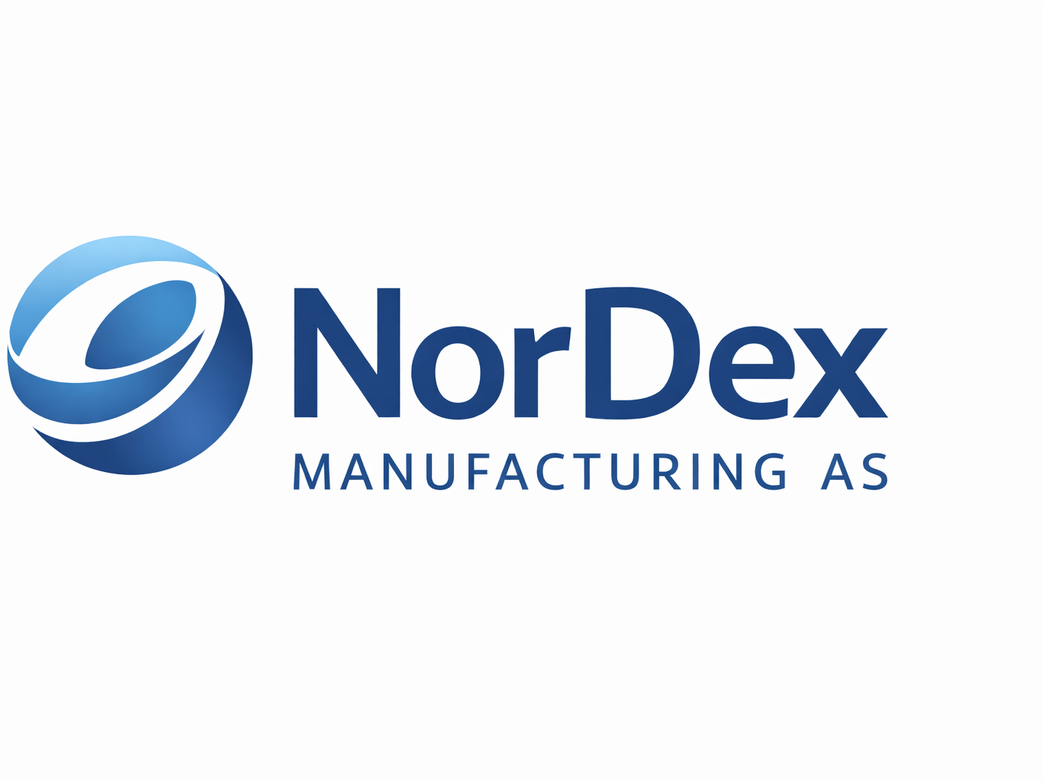
Shift Performance Analytics & Operational Insights
Leveraging data analytics and Machine Learning to Enhance Operational Efficiency
Presented By: Esivwekpe Efemini
Date: 29th December 2025

Slide 2

Project Overview
The purpose of this project is to leverage data analytics and machine learning to optimize shift performance by identifying key performance drivers, forecasting shift efficiency, and implementing data-driven scheduling.
Enhance shift-level performance to standardize output, minimize inefficiencies, and boost overall operational efficiency across NorDex plants.

Slide 3
Project objectives
Measure shift-wise production performance
Analyze quality control trends and defect patterns
Evaluate impact of environmental conditions
Create a single, trusted performance view
Deliver insights through an interactive Streamlit dashboard

Slide 4

Expectations & Success Criteria
What success looks like
Clear identification of:
High-performing and underperforming shifts
Quality risk areas
Easy access to KPIs for managers
Reduction in manual reporting effort
Foundation for future predictive analytics

Slide 5

Solution Architecture Overview
Data Integration & Reliability
Integrated Nordex manufacturing data using pyodbc for secure SQL server connectivity
Enabled real-time data ingestion to support timely and reliable insights
Automated data cleaning and feature engineering to ensure high data quality
Predictive Modeling Approach
Applied a Gradient Boosting Regressor to achieve strong predictive performance
Leveraged feature preprocessing to capture key operational patterns
Validated results using R² Score and Mean Absolute Error to ensure model accuracy
Insights, Monitoring & Value Delivery
Developed real-time dashboards for continuous performance monitoring
Delivered analytics to support performance optimization initiatives
Enabled predictive simulation capabilities to evaluate potential operational scenarios

Slide 6
Operational Performance Insights & Business Impact
Shift-Level Performance Comparison
Morning Shift: Delivers the highest efficiency and output, directly contributing to increased throughput and lower unit cost
Evening Shift: Maintains stable performance, offering potential for incremental efficiency gains
Night Shift: Presents improvement opportunities that can reduce variability, rework, and operational risk
Key Drivers of Operational Performance
Production Volume: Primary contributor to overall efficiency and revenue realization
Operator Experience: Higher experience levels reduce defects and associated rework costs
Downtime Duration: Directly impacts Overall Equipment Effectiveness (OEE) and asset utilization
Environmental Conditions: Temperature and humidity influence process stability and output consistency
Maintenance Strategy: Preventive maintenance minimizes unplanned downtime and improves cost predictability
Targeted improvements in shift performance, maintenance strategy, and quality control can significantly reduce costs, improve OEE, and increase production reliability.

Slide 7
Machine Learning Model Performance & Business Value
Model Evaluation Summary
Compared baseline Linear Regression with Gradient Boosting
Performance assessed using R² (predictive accuracy) and Mean Absolute Error (MAE)
Model Selection Rationale
Gradient Boosting Regressor demonstrated higher predictive accuracy
Better at capturing complex relationships in operational data
Lower prediction error improves reliability of forecasts and planning
Key Business Capabilities Enabled
Predicts production efficiency and output trends
Identifies operational configurations impacting performance
Supports scenario planning and proactive decision-making
Enhances confidence in data-driven management actions
Model | R² | MAE
Linear Regression (Baseline) | 0.932 | 2.68
Gradient Boosting (Selected) | 0.945 | 2.41

Slide 8



Interactive Dashboard Capabilities
Interactive Dashboard Capabilities
Tab 1: Shift Performance Summary
Live Key Metrics: Units produced, defect rates, downtime, and Overall Equipment Effectiveness (OEE)
Shift Comparison Charts: Visual insights into performance across shifts
Monthly Trends: Historical analysis to identify recurring patterns
Efficiency Tracking: Monitor and benchmark shift-level productivity
Tab 3: Predictive Insights & Optimization
Shift Simulator: Test alternative shift configurations
Efficiency Forecasting: Predict performance using historical data
Optimization Explorer: Top 10 actionable recommendations
Scenario Testing: Evaluate potential outcomes before implementation
Tab 2: Operator & Machine Analytics
Skill Mix Visualization: Assess operator capabilities and distribution
Defect Correlation: Link operator experience to defect rates
Downtime Rankings: Identify machines with highest downtime
Maintenance Logs: Track and analyze maintenance events

Slide 9

Business Impact & ROI
Quantifiable Benefits
⚙️Operational Efficiency
Enhanced unit-level performance
Lower defect rates via intelligent scheduling
Predictive maintenance reduces unplanned downtime
📊 Decision Making
Smarter shift planning with real-time data
Continuous performance monitoring
AI-driven resource allocation
💰 Cost Savings
Reduced rework through defect prevention
Optimized operator deployment
Lower spare part consumption
💎 Strategic Advantages
Competitive edge through operational excellence
Scalable framework for future expansion
Foundation for Industry 4.0 transformation

Slide 10
Strategic Recommendations
🔥 Immediate Actions (0–3 Months)
Launch dashboard for production managers
Apply experience-based shift scheduling
Deliver targeted training on dimensional quality
Promote best practices from high-performing morning shifts
📈 Medium-Term Initiatives (3–6 Months)
Expand predictive models with additional variables
Integrate dashboard with ERP systems
Build automated alerting mechanisms
Introduce operator performance scorecards
🚀 Long-Term Vision (6–12 Months)
Enable AI-driven autonomous shift optimization
Implement predictive maintenance workflows
Deploy real-time quality control adjustments
Establish cross-plant performance benchmarking

Slide 11
Technical Implementation Details
🛠️ Technology Stack
Database: SQL Server (NordexManufacturing2)
Analytics: Python (pandas, scikit-learn, numpy)
Visualization: Streamlit, matplotlib, seaborn
Model Deployment: joblib-based pickle serialization
📊 Data Processing
Analyzed 31 variables across shifts, operators, and machines
Engineered features for KPI calculations
Performed correlation analysis and statistical profiling
Built a real-time data pipeline for continuous insights
🧠 Model Pipeline
Preprocessing: OneHotEncoder for categorical variables
Algorithm: Gradient Boosting (100 estimators)
Validation: Train/test split with cross-validation
Deployment: Integrated into Streamlit dashboard for live scoring

Slide 12

Implementation Roadmap
🚀 Phase 1: Deployment (Weeks 1–2)
Dashboard training for production managers
Configure user access and permissions
Establish initial performance baseline
🔧 Phase 2: Optimization (Weeks 3–6)
Apply top 10 recommended configurations
Monitor performance improvements
Collect user feedback and iterate
📈 Phase 3: Expansion (Weeks 7–12)
Scale deployment to additional production lines
Integrate advanced dashboard features
🎯 Success Metrics
10% uplift in overall shift efficiency
20% reduction in defect rates
15% decrease in unplanned downtime

